Slide 1
Rockbuster Online Store Launch Strategy
By Jinita Patel

Slide 2
Agenda
01
02
03
04
05
Introduction & Film Data summary
Top Rental Locations
Genre Preferences
06
Film Ratings Preferences
Recommendations & Next Steps
Appendix

Slide 3
01. Launch of Online Store
Rockbuster will be launching online video rental service using existing movie licenses to stay competitive with other streaming services such as Amazon Prime and Netflix.
Digital movie rentals via internet services saw a 9% increase in sales in the U.S
In 2019 subscription streaming represented 63% of home entertainment market share, increasing by 23.7% from 2018
From 2015 to 2019, Netflix’s revenue increased from 7 to 25 billion dollars
In US, video rental spending dropped by 12.3% to $3.4 billion in 2019

Slide 4












Film Data Summary
Below is the summary of film data used to conduct the analysis.
Films
Genres & Actors
Customers
1,000 Films
20 genres
599 customers
$2.98 Avg rental price
108 locations
200 actors
$0.99 common rental price
Payments
584 active customers
5 days avg rental duration
14,596 payments
16,044 total rentals
Movies are in English language
$61,312 total revenue

Slide 5
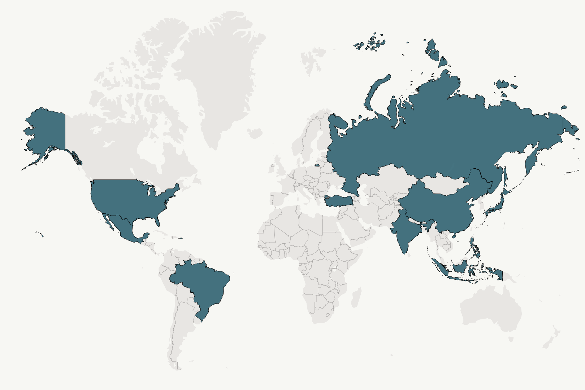










0.2 Top 10 Countries by Revenue
1
6
Brazil 4.7%
India 10%
2
7
Russia 4.7%
China
9%
3
8
Philippines 4.3%
U.S
6%
4
Japan
5.2%
9
Turkey 2.5%
India & China generate most revenue
5
10
Mexico
5%
Indonesia 2.3%

Slide 6
Revenue & Customer Distribution by Country
A strong relationship exists between customer count and revenue. As the customer base grows in a country, so does the revenue.
India
China
U.S
Top 10 generate 53% of the total revenue

Slide 7
Top 10 Cities in Top 10 Countries
Country | City | Customers | Revenue
United States | Aurora | 2 | $159.58
United States | Cape Coral | 1 | $208.58
Brazil | Santa Brbara dOeste | 1 | $194.61
United States | Memphis | 1 | $167.67
Philippines | Tanza | 1 | $166.61
India | Valparai | 1 | $162.67
Philippines | Santa Rosa | 1 | $161.68
Philippines | Tanauan | 1 | $156.66
India | Halisahar | 1 | $154.70
India | Bijapur | 1 | $154.66
Aurora is the only city with more than 1 customer
Cape Coral city generates the most revenue
United States, Philippines and India each hold 3 of the top 10 cities that generate the most revenue
Top 10 cities in the top 10 countries contribute 2.75% of the overall revenue

Slide 8
Top 5 High Value Customers
Below high value customers contributed 1.5% to total revenue
First Name | Last Name | City | Country | Revenue
Karl | Seal | Cape Coral | United States | $208.58
Marion | Snyder | Santa Brbara dOeste | Brazil | $194.61
Ana | Bradley | Memphis | United States | $167.67
Marcia | Dean | Tanza | Philippines | $166.61
Mike | Way | Valparai | India | $162.67

Slide 9
03. Rentals & Revenue by Genre
Sports films led in rentals and revenue
Top Revenue Generators: Sports, Sci-fi, Animation films
Popular Rentals: Sports, Animation, Action films
Sci-fi outperforms Animation and Action in revenue due to its higher average rental rate
Action ranks top 3 in rentals but 7th in revenue, due to its lower rental rate
Low Popularity and Revenue Generators: Thriller, Romance, Crime and War
Follow the link in the graph to modify its data and then paste the new one here. For more info, click here

Slide 10
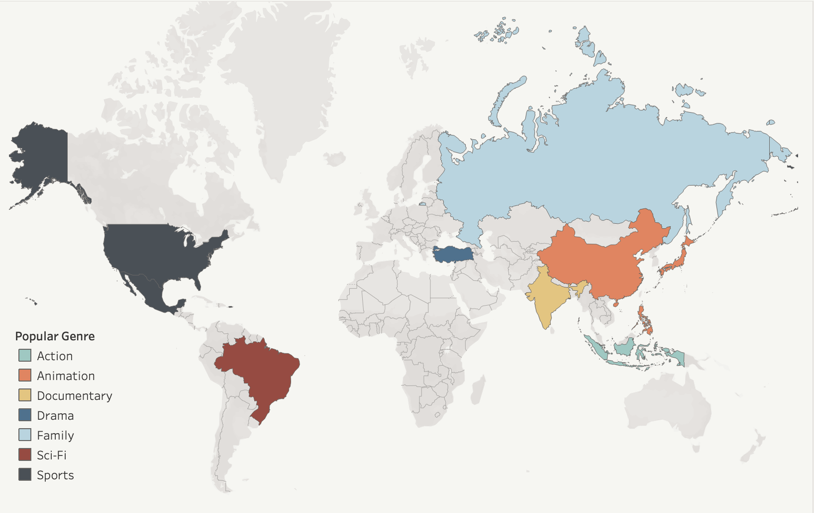
Top Genres in Top 10 Countries
Family is preferred genre Russia
Sports is preferred genre in U.S and Mexico
Animation is preferred genre in Japan, China Philippines
Sc-fi is preferred genre in Brazil
Documentary is preferred genre in India
Drama is preferred genre in Turkey
Action is preferred genre in Indonesia
Click here to enlarge the map

Slide 11
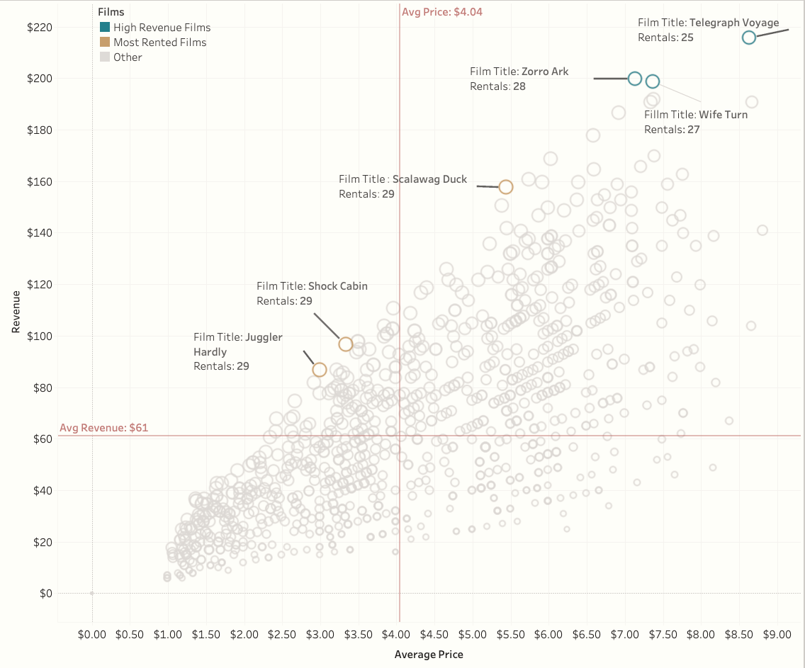
Avg. Rental Price, Rentals & Revenue Correlation
A strong correlation between average rental price and revenue. When the average price rises, revenue also climbs
Films such as Telegraph Voyage, Zorro Arc and Wife Turn generate more revenue despite lower rental frequency compared to Shock Cabin and Juggler Hardly
2005-2006 average rental price was $4.04
Rental frequency and revenue share a moderate positive correlation, indicating that as a film is rented more frequently, it generates higher revenue.
2005-2006 on average films were rented 15 times
Click here to enlarge the graph

Slide 12
04. Rentals & Revenue by Film Ratings
PG-13 film are most popular globally and generate the most revenue
Rentals
Customers
Follow the link in the graph to modify its data and then paste the new one here. For more info, click here

Slide 13




05. Recommendations
Concentrate the online store launch on the top 10 countries with substantial customer bases and revenue generation.
Our analysis indicates that different regions have unique genre preferences. We recommend tailoring the product and marketing to match these regional preferences. Please note that the data used for this analysis is for rentals in 2005-2006 and we recommend gathering more recent data to accurately identify region-specific genre preferences for 2020 marketing strategies.
The data indicates that higher rental prices, along with more frequent rentals, lead to increased revenue. We recommend testing price elasticity by raising the rental fees for movies rented over 15 times and priced under $4.04 by 10%. This will help identify optimal rental rate to maximize revenue. Additionally, to set prices tailored to specific regions, we recommend obtaining updated rental data and understanding local video rental and streaming market trends.
There exists a strong correlation between the number of customers and overall revenue. To boost revenue, it's advisable to direct marketing efforts towards expanding the customer base in the top 10 countries. Further region-specific market research is required.

Slide 14
Next Steps
Gather and analyse the top 10 countries' markets to determine:
Size of the home entertainment market in terms of revenue in 2019. This includes market share held by digital rental, subscription streaming services and video purchases
Profit margin on sales in the digital rental market
Share of the market Rockbuster will need to hold to become profitable
Region specific customer segments using more recent data (2018-2019)
Barriers to enter each country’s market.
Analyse Rockbuster’s resources, investment and ROI:
What costs will be required to launch the online store in each country?
What type of resources will be required for the launch? Does Rockbuster have these resources?
How long will it take to payback investments
How long will it take to breakeven

Slide 15
0.6 Appendix
Rockbuster Stealth Data Analysis Project Brief
Rockbuster Explorative Data Analysis
Rockbuster Data Dictionary
Map & Scatterplot graph in the presentation
2019 U.S Home Entertainment Statistics

Slide 16
Thank YOU

